Slide 1
“Hey Stand Still” – Being Stationary is Where Its At in Time Series…

Slide 2
Step 3: Analysis Run
The Important Idea of a Time Series Being Stationary
We need to crawl first before we can walk in times series. So we are going to start out dealing with time series that are stationary.
In non-technical terms, a stationary time series means that no matter part of the time series you examine, it is expected that the mean and the variance is constant over time. We know this because…
The entire joint distribution of two different series of points in time the mean and variance will be constant. That is, over the long run, the joint distribution of y_{t}, y_{t+1}, y_{t+2}, y_{t+3} will be the same as the joint probability distribution y_{t+k}, y_{t+k+1}, y_{t+k+2}, y_{t+k+3}
Also, the autocorrelation is also constant over time. Autocorrelation means the tendency for one data point at time t to be correlated with the data point at point time t-1. Autocorrelations are usually positive.

Slide 3
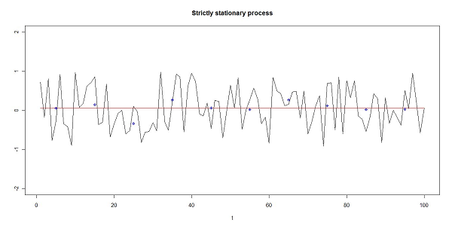
Step 3: Analysis Run
Stationary Time Series
Here is a strictly stationary time series. Note that the trend line through the points is flat or slope of zero, that is the mean does not change across time.

Slide 4
Step 3: Analysis Run
Stationary Time Series
Although a little harder to imagine, note that the variance across time appears to be pretty constant – there are no “squished” parts of the time series and no obvious sections of large outliers.

Slide 5
Step 3: Analysis Run
Stationary Time Series
Also note that across time, although hard to visualize,data points tend to seem to have very similar patterns of positive autocorrelation. If all three conditions are met, then the time series is strictly stationary. If the autocorrelation changed across time but the mean and variance stayed the same, then the time series is called “weak stationary”.

Slide 6
Step 3: Analysis Run
Stationary Time Series
We should note that in the real world strictly stationary time series are pretty rare. It’s really kind of an extreme scenario that turns out to be useful.
Why is a time series being stationary helpful? Because if you base your model off one part of the time series, then you know that the new time series points it forecasts will have to have the same mean, variance and autocorrelation. That makes for happier modeling!

Slide 7
Step 3: Analysis Run
Back to Autocorrelation
Let’s return to autocorrelation again for a moment.
You can examine the autocorrelation for any number of time lags between data points.
For example, you can look at the correlation between some data point y_{t} and y_{t-1}. That would be the autocorrelation for a lag of 1.
You can look at the correlation between some data point y_{t} and y_{t-2} which would be the autocorrelation for a lag of 2.
You can look at the correlation between some data point y_{t} and y_{t-3} which would be the autocorrelation for a lag of 3.

Slide 8
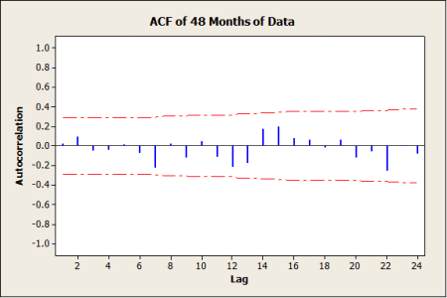
Step 3: Analysis Run
Back to Autocorrelation
We can plot out the autocorrelation for each of the lags on a plot, like the one below. This plot is a plot of the autocorrelation function or ACF.

Slide 9
Step 3: Analysis Run
Back to Autocorrelation
Notice that the pattern of autocorrelations varies – sometimes positive, sometimes negative. That is pretty typical of a stationary time series. Also note that none of the autocorrelations exceed the pvalue = .05 signified by the red dashed line. So the autocorrelations can assumed to be zero for all the lags and this confirms our hunch that the time series is stationary.

Slide 10
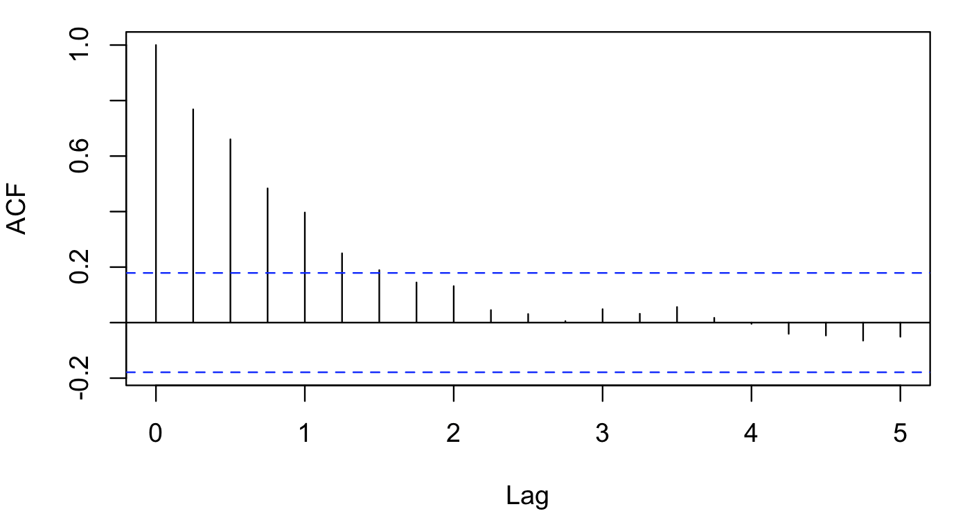
Step 3: Analysis Run
Back to Autocorrelation
Now what does the ACF look like for a non-stationary time series?
Notice that for the most part the autocorrelations are positive and don’t flip flop back and forth as much as the stationary example.
Importantly, note that the positive correlations reach beyond the blue dashed line of pvalue =.05, which means they are non-zero.

Slide 11
Step 3: Analysis Run
Back to Our Radio Sales Data
Now let’s look at our radio sales. Let’s see if it is stationary.
We can draw a trend line through it to see if there is no trend – that is, the mean is constant across all time points – that’s one of the criteria for a stationary time series. Does it look like there is NO trend?
.

Slide 12
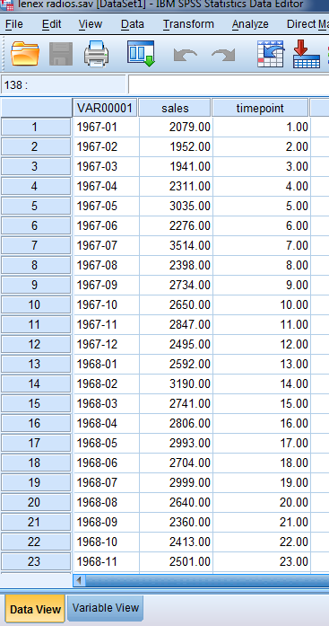
Step 3: Analysis Run
Is there just a single mean?
We can run a regression, regressing the each timepoint against sales.
If there is a trend, then we should see in the results of the multiple regression a significant overall regression model and a statistically significant pvalue for our timepoint variable.
Let’s see if that is the case!
.

Slide 13
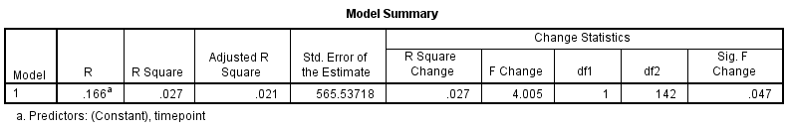
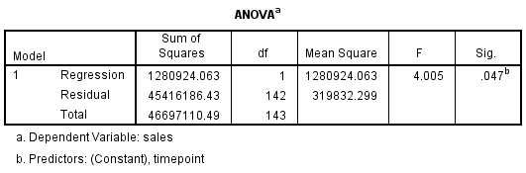
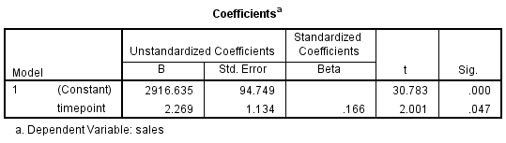
Step 3: Analysis Run
Is there just a single mean?
Here is the result of the regression. Does it look like the model is significant?
Does the regression coefficient for timepoint have a pvalue < .05?
Is this further evidence that the radio sales data is not stationary?
Warning: I am using this to illustrate a point – we know that the autocorrelation in time series data artificially reduces the standard errors of the regression coefficients and so this test is technically not correct, but I want to use it here as a pedagogical crutch…
.

Slide 14
Step 3: Analysis Run
Is there just a single mean?
In fact, our Durbin Watson for this time series data set is 0.637, which indicates serial autocorrelation – which is what we would expect from a time series with trend in it!
…
.

Slide 15

Step 3: Analysis Run
Back to Autocorrelation
Let’s try the ACF now with our radio sales data set
Does our radio sales data ACF look similar to the non-stationary example we discussed earlier?
Our radio sales time series
Our example non-stationary time series

Slide 16
Step 3: Analysis Run
So no – our radio sales data is likely not stationary
Should we just pack up and head for Hills and Dales?
No, not yet! We can remove the trending component of our radio sales data and then it will be stationary!

Slide 17
Step 3: Analysis Run
Differencing
We can do something called differencing to get rid of the non-stationary component of the data (e.g. the trend).
We can do what’s called first differencing on our data. Here is the formula:
Xt = y_{t} - y_{t-1} = ∆y_{t}
Note: we could also try to do this by regressing the timepoint against sales and use the errors or residuals from that regression to remove the trend. But that assumes the trend is the same everywhere and it may not be. However, differencing is not affected by changes in trend and so it works regardless, so differencing is better for us.

Slide 18
Step 3: Analysis Run
Back to Our Radio Sales Data
Now let’s look at our radio sales. Let’s see if it is stationary.
We can draw a trend line through it to see if there is no trend – that is, the mean is constant across all time points – that’s one of the criteria for a stationary time series. Does it look like there is NO trend?
.

Slide 19
Step 3: Analysis Run
Back to Our Radio Sales Data after differencing
Now that I have differenced the radio sales data, does our ACF plot look any better? Yes it does!.

Slide 20
Step 3: Analysis Run
Is there just a single mean?
There are also actual tests for single mean (e.g. no trend) available in Gretl to help our stationarity tests
KPSS test
Augmented Dickey Fuller
Each of these tests correctly tests for the single mean condition in the data

Slide 21
Step 3: Analysis Run
Did differencing give us a single mean?
Here is the KPSS test for our differenced radio sales data – it should show a p > .05 value than before differencing
H₀: no evidence data has more than one mean (fits stationary criteria)
Halt: data has more than one mean (e.g. non-stationary)
Because p > .05, we cannot reject h₀ and so there is no evidence of more than one mean (fits criteria for stationary time series)

Slide 22
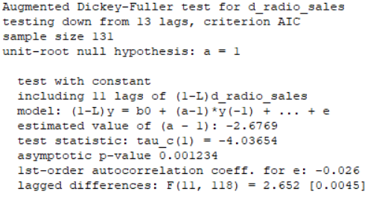
Step 3: Analysis Run
Did differencing give us a single mean?
Here is the Augmented Dickey Fuller test for our differenced radio sales data – it should show a p > .05 value than before differencing
H₀: data has more than one mean (e.g. non-stationary)
Halt: data has one mean (e.g. stationary)
Notice that this is just the opposite hypotheses of the KPSS test!!!
Because p > .05, we cannot reject h₀ and so there is no evidence of more than one mean (fits criteria for stationary time series)

Slide 23

Step 3: Analysis Run
Did differencing give us a single mean?
Here one more test – available in SAS - the Phillips-Perron test for our differenced radio sales data
H₀: no evidence data has single mean
Halt: data have single mean
Because p < .05 for single mean, we reject the null hypothesis and say there is evidence that there is only a single mean in the data (e.g. fits criteria for stationary time series)

Slide 24
To every season, turn, turn, turn…

Slide 25
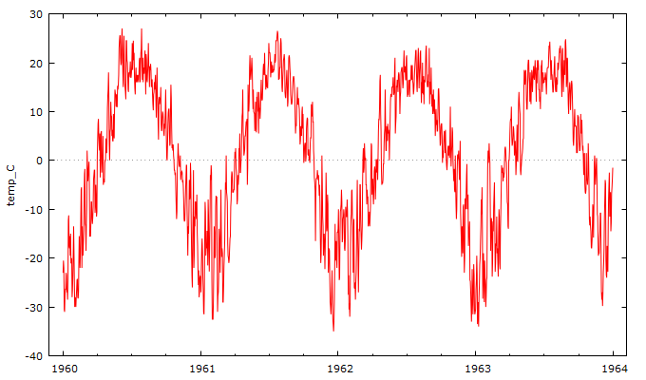
Step 3: Analysis Run
Seasonality
Remember we talked about seasonality? So here are the daily temperatures (in centigrade) for Dallas from 1960 to 1964. As you can clearly see, the seasons of the year play a big part in temperature.

Slide 26
Step 3: Analysis Run
Seasonality
Can we get rid of that seasonality? Then we could see what is left and decide if we can use time series models to model some more of it.

Slide 27
Step 3: Analysis Run
Seasonality
We can use differencing to get rid of seasonality as well.
We can do what’s called first differencing on our data. Here is the formula where d is the length of the season or period
∆_{d}y_{t} = y_{t} - y_{t-d}

Slide 28
Step 3: Analysis Run
Seasonality
So in this case since it’s daily temps, the period or seasonal d = 365 days
∆_{d}y_{t} = y_{t} - y_{t-365}

Slide 29
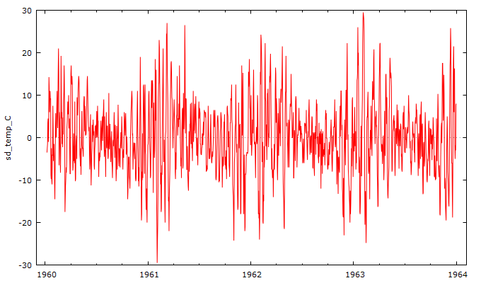
Step 3: Analysis Run
Seasonality
And here is the result…
∆_{d}y_{t} = y_{t} - y_{t-365}

Slide 30
Step 3: Analysis Run
Seasonality
Note you can also remove seasonality using regression models, but the models can be very, very ugly, so differencing is our best friend here…

Slide 31
So let’s see how this all fits together

Slide 32
Step 3: Analysis Run
So Let’s Restate the Time Series Process
Plot the time series and its basic features
Eliminate any trend or seasonal components
Develop a forecasting model for what’s left
Validate the model using a split sample technique
Examine the original data versus the fitted data
Examine the future arriving data versus the forecast data
Produce confidence intervals around the predictions
Monitor the forecasting model to ensure it doesn’t go in the ditch

